Slide 1

Practice Your Programming with Katas
Session 8: Quo Vadimus?

Slide 2

Week 8: Come fly with me! http://eca-katas/session8
MI:7 know that an Urmanian Agent is planning to leave the UK by bribing a SkeezyJet desk attendant to obtain a ticket. They have several leads as to the possible departure airport and destination.
We need to verify which leads are valid.
Write a function that verifies if a given destination is reachable using only SkeezyJet flights from a given airport.
SkeezyJet route data has been provided in the example code – bear in mind that the Urmanian Agent may change planes!
Your function should return True if the destination can be reached (and hence it’s a valid lead), False otherwise.

Slide 3
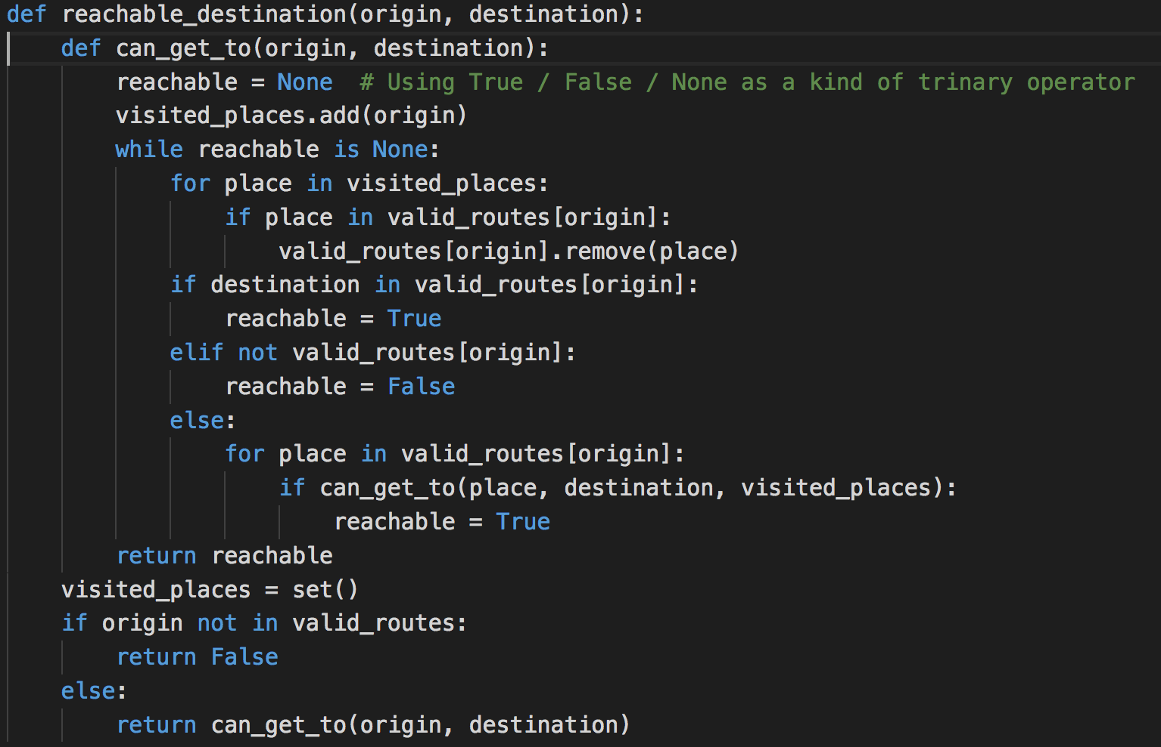
Inner Function

Slide 4
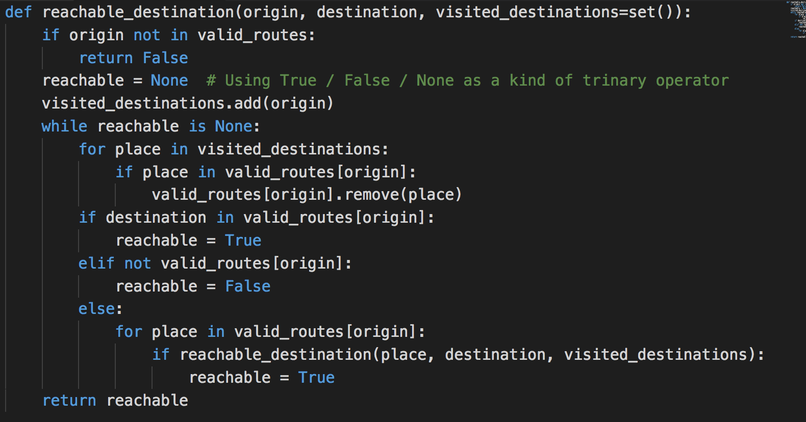
Secret hidden argument

Slide 5
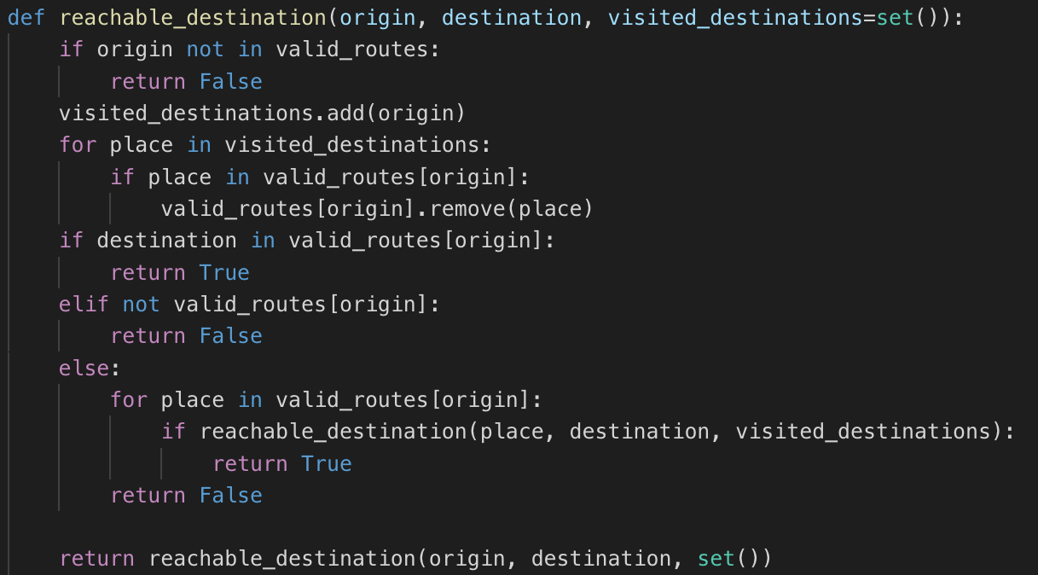
“Hey, wait a minute…” moment

Slide 6
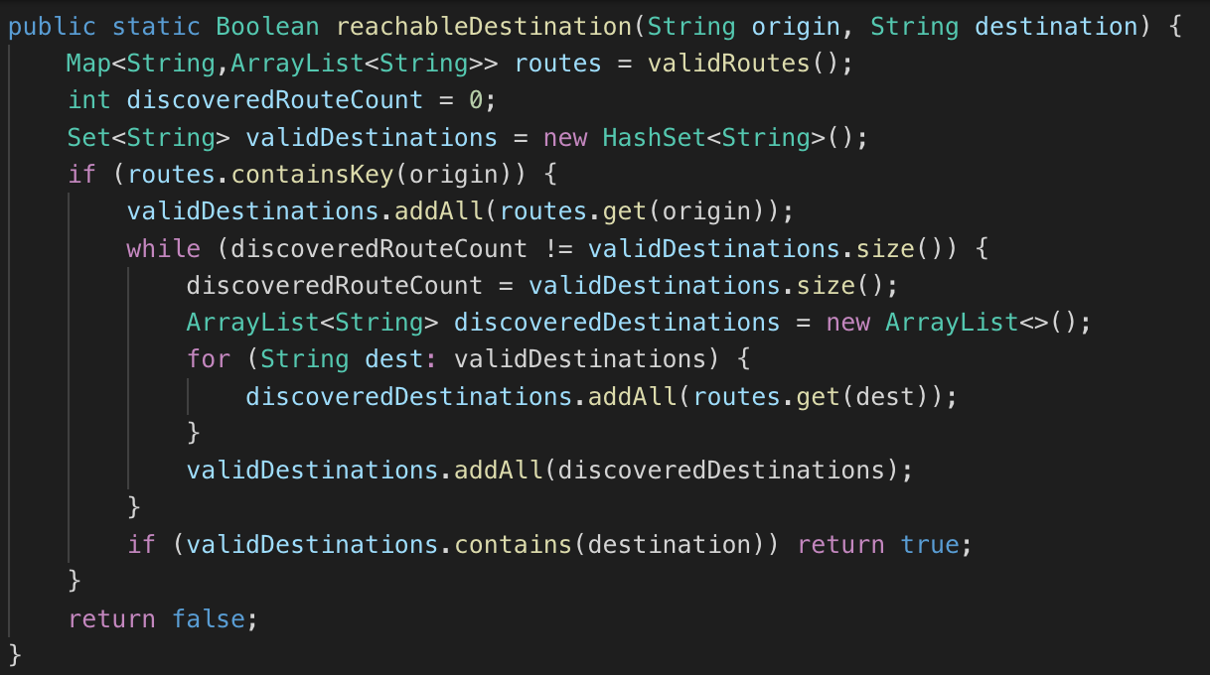
In-flight serving of Java

Slide 7
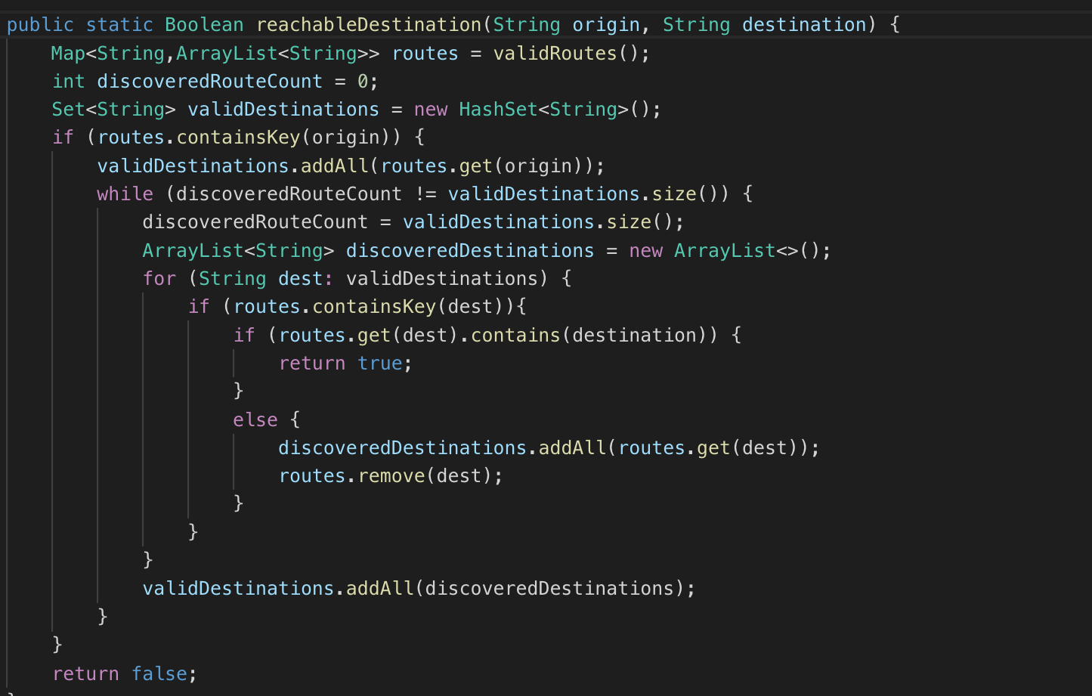
Optimised Java

Slide 8
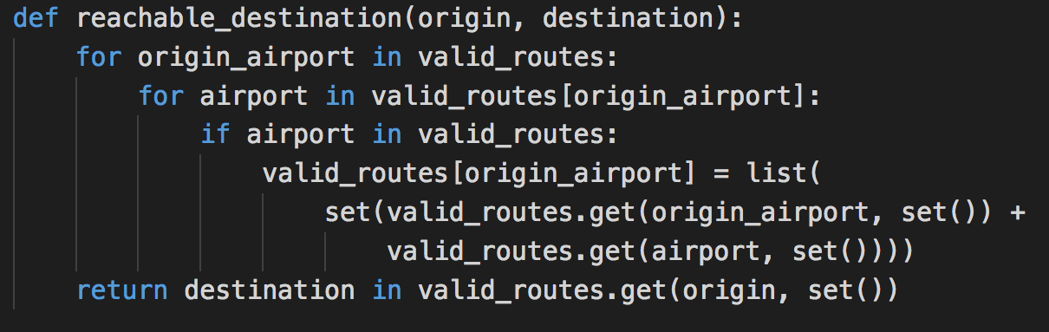
Why does this work?

